Slide 1

GNOME
SORT
Brought to you by Team Stupid:
Raymond Aya-ay, Jomer Barcenilla, Erik Celdran, Kevin Marte

Slide 2
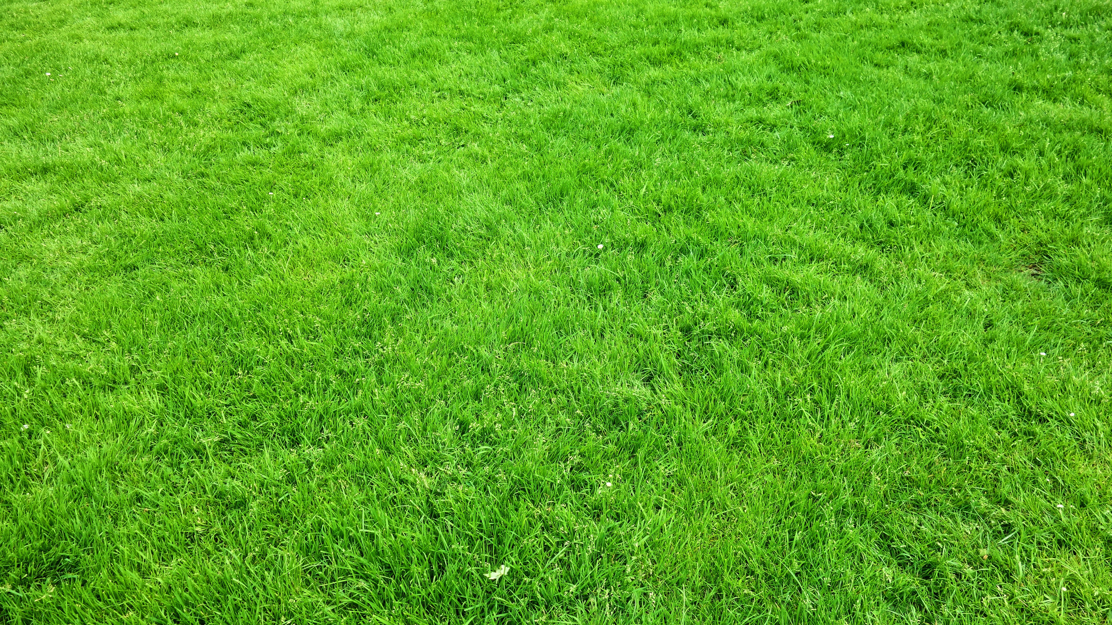
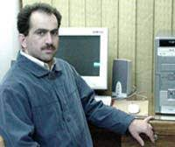
Hamid Sarbazi-Azad
Professor of Computer Science and Engineering at Sharif University of Technology

Slide 3
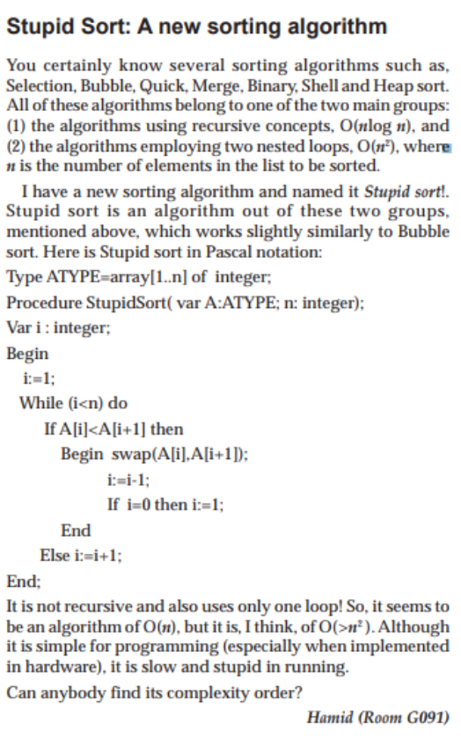
Gnome sort was originally proposed by the Iranian computer scientist in 2000.
The sort was first called stupid sort and then later described by Dick Grune as a gnome sort.

Slide 4
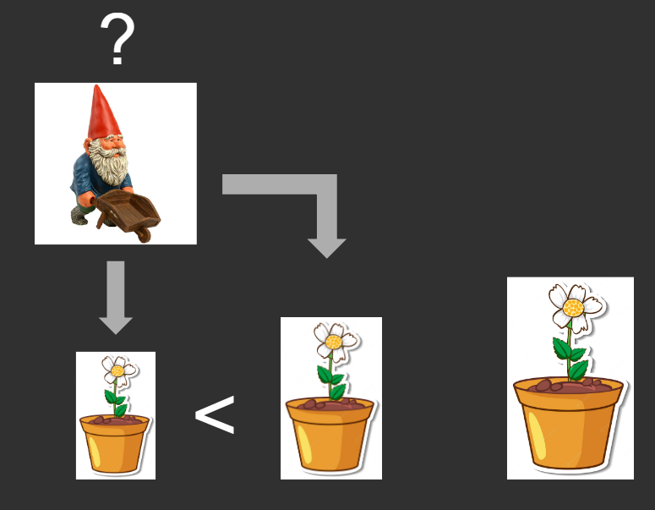
Gnome Sort is based on the technique used by the standard Dutch Garden Gnome

Slide 5
Basically, he looks at the flowerpot next to him and the previous one; if they are in the right order he steps one pot forward, otherwise, he swaps them and steps one pot backward.

Slide 6



SIMULATION
Let's Sort my flowers

Slide 7


SIMULATION
0
3
5
9
1
7
2
6
4
0
1
2
3
4
5
6
7

Slide 8
SIMULATION
1
3
5
9
1
7
2
6
4
0
1
2
3
4
5
6
7

Slide 9

SIMULATION
2
3
5
9
1
7
2
6
4
0
1
2
3
4
5
6
7

Slide 10
SIMULATION
2
3
5
1
9
7
2
6
4
0
1
2
3
4
5
6
7

Slide 11
SIMULATION
1
3
5
1
9
7
2
6
4
0
1
2
3
4
5
6
7

Slide 12
SIMULATION
1
3
1
5
9
7
2
6
4
0
1
2
3
4
5
6
7

Slide 13
SIMULATION
0
3
1
5
9
7
2
6
4
0
1
2
3
4
5
6
7

Slide 14
SIMULATION
0
1
3
5
9
7
2
6
4
0
1
2
3
4
5
6
7

Slide 15
SIMULATION
1
1
3
5
9
7
2
6
4
0
1
2
3
4
5
6
7

Slide 16
SIMULATION
2
1
3
5
9
7
2
6
4
0
1
2
3
4
5
6
7

Slide 17
SIMULATION
3
1
3
5
9
7
2
6
4
0
1
2
3
4
5
6
7

Slide 18
SIMULATION
3
1
3
5
7
9
2
6
4
0
1
2
3
4
5
6
7

Slide 19
SIMULATION
2
1
3
5
7
9
2
6
4
0
1
2
3
4
5
6
7

Slide 20
SIMULATION
3
1
3
5
7
9
2
6
4
0
1
2
3
4
5
6
7

Slide 21
SIMULATION
4
1
3
5
7
9
2
6
4
0
1
2
3
4
5
6
7

Slide 22
SIMULATION
4
1
3
5
7
2
9
6
4
0
1
2
3
4
5
6
7

Slide 23
SIMULATION
3
1
3
5
7
2
9
6
4
0
1
2
3
4
5
6
7

Slide 24
SIMULATION
3
1
3
5
2
7
9
6
4
0
1
2
3
4
5
6
7

Slide 25
SIMULATION
2
1
3
5
2
7
9
6
4
0
1
2
3
4
5
6
7

Slide 26
SIMULATION
2
1
3
2
5
7
9
6
4
0
1
2
3
4
5
6
7

Slide 27
SIMULATION
1
1
3
2
5
7
9
6
4
0
1
2
3
4
5
6
7

Slide 28
SIMULATION
1
1
2
3
5
7
9
6
4
0
1
2
3
4
5
6
7

Slide 29
SIMULATION
0
1
2
3
5
7
9
6
4
0
1
2
3
4
5
6
7

Slide 30
SIMULATION
1
1
2
3
5
7
9
6
4
0
1
2
3
4
5
6
7

Slide 31
SIMULATION
1
1
2
3
5
7
9
6
4
0
1
2
3
4
5
6
7

Slide 32
SIMULATION
2
1
2
3
5
7
9
6
4
0
1
2
3
4
5
6
7

Slide 33
SIMULATION
3
1
2
3
5
7
9
6
4
0
1
2
3
4
5
6
7

Slide 34
SIMULATION
4
1
2
3
5
7
9
6
4
0
1
2
3
4
5
6
7

Slide 35
SIMULATION
5
1
2
3
5
7
9
6
4
0
1
2
3
4
5
6
7

Slide 36
SIMULATION
5
1
2
3
5
7
6
9
4
0
1
2
3
4
5
6
7

Slide 37
SIMULATION
4
1
2
3
5
7
6
9
4
0
1
2
3
4
5
6
7

Slide 38
SIMULATION
4
1
2
3
5
6
7
9
4
0
1
2
3
4
5
6
7

Slide 39
SIMULATION
3
1
2
3
5
6
7
9
4
0
1
2
3
4
5
6
7

Slide 40
SIMULATION
4
1
2
3
5
6
7
9
4
0
1
2
3
4
5
6
7

Slide 41
SIMULATION
5
1
2
3
5
6
7
9
4
0
1
2
3
4
5
6
7

Slide 42
SIMULATION
5
1
2
3
5
6
7
9
4
0
1
2
3
4
5
6
7

Slide 43
SIMULATION
6
1
2
3
5
6
7
9
4
0
1
2
3
4
5
6
7

Slide 44
SIMULATION
6
1
2
3
5
6
7
4
9
0
1
2
3
4
5
6
7

Slide 45
SIMULATION
5
1
2
3
5
6
7
4
9
0
1
2
3
4
5
6
7

Slide 46
SIMULATION
5
1
2
3
5
6
4
7
9
0
1
2
3
4
5
6
7

Slide 47
SIMULATION
4
1
2
3
5
6
4
7
9
0
1
2
3
4
5
6
7

Slide 48
SIMULATION
4
1
2
3
5
6
4
7
9
0
1
2
3
4
5
6
7

Slide 49
SIMULATION
4
1
2
3
5
4
6
7
9
0
1
2
3
4
5
6
7

Slide 50
SIMULATION
3
1
2
3
5
4
6
7
9
0
1
2
3
4
5
6
7

Slide 51
SIMULATION
3
1
2
3
4
5
6
7
9
0
1
2
3
4
5
6
7

Slide 52
SIMULATION
2
1
2
3
4
5
6
7
9
0
1
2
3
4
5
6
7

Slide 53
SIMULATION
3
1
2
3
4
5
6
7
9
0
1
2
3
4
5
6
7

Slide 54
SIMULATION
4
1
2
3
4
5
6
7
9
0
1
2
3
4
5
6
7

Slide 55
SIMULATION
5
1
2
3
4
5
6
7
9
0
1
2
3
4
5
6
7

Slide 56
SIMULATION
6
1
2
3
4
5
6
7
9
0
1
2
3
4
5
6
7

Slide 57
SIMULATION
7
1
2
3
4
5
6
7
9
0
1
2
3
4
5
6
7

Slide 58

SIMULATION
SUCCESS!!!
1
2
3
4
5
6
7
9
0
1
2
3
4
5
6
7

Slide 59
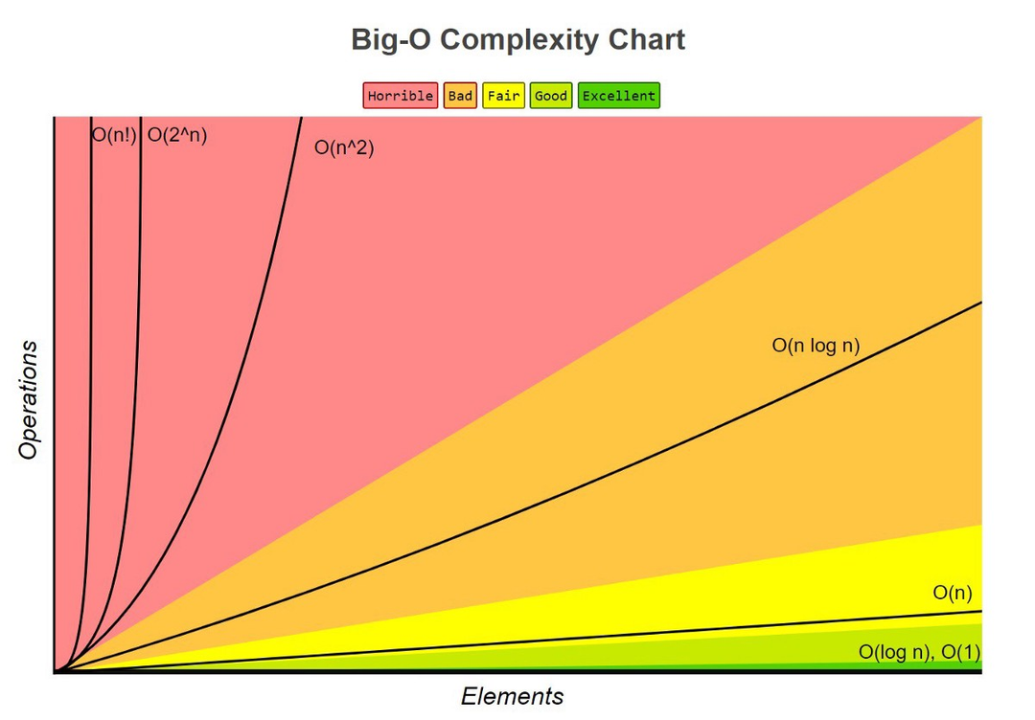
TIME AND SPACE
COMPLEXITY
Time Complexity
Best Case: 0(N)
Average Case: 0(N2)
Worst Case: 0(N2)
Space Complexity: 0(1)

Slide 60
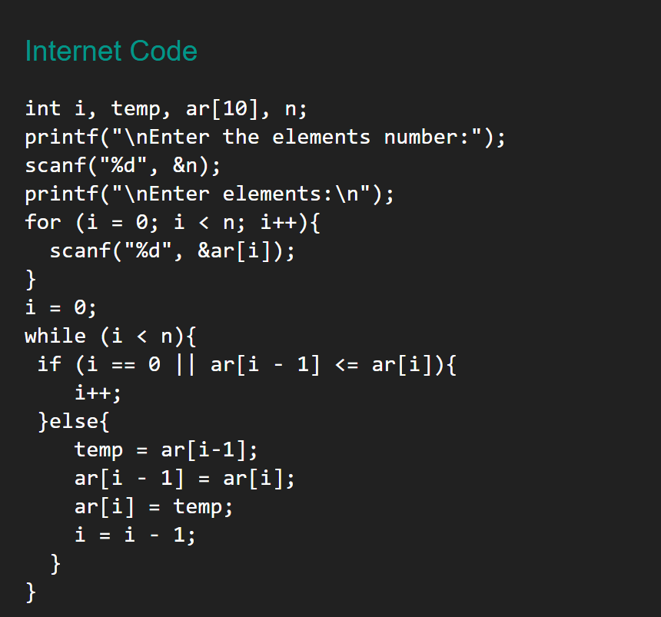
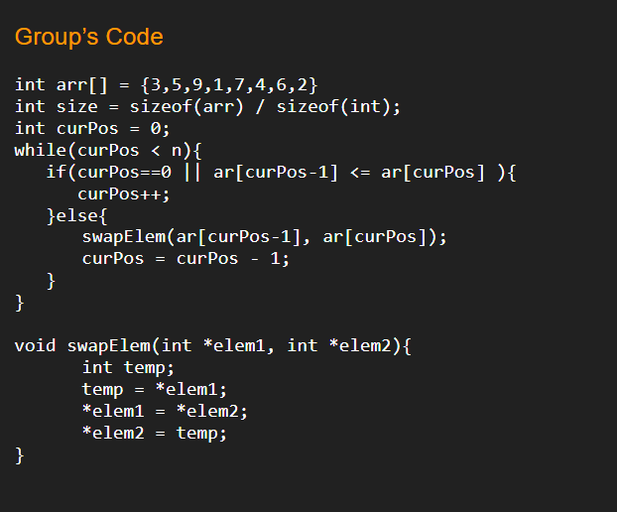
CODE COMPARISON

Slide 61
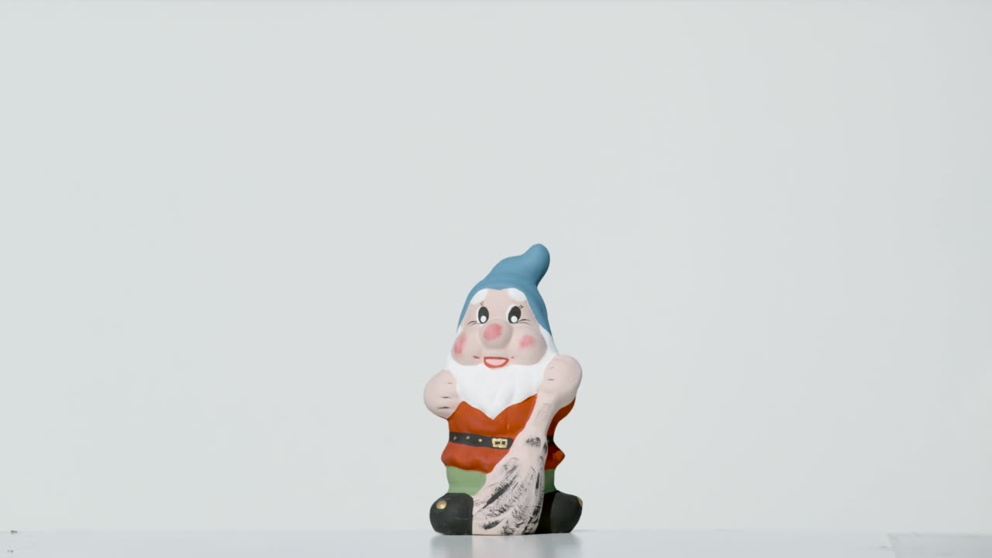
Team Stupid
THANK YOU!

